Slide 1

Progress on one-second data Jan Reda
Intermagnet Meeting Online, 13-15 Jul 2020

Slide 2
1-sec Definitive Data collection
2014..2019
(situation 2020-07-03)
Definitive 2014
Provided 38 IMOs
Accepted 36 IMOs
Definitive 2015
Provided 36 IMOs
Accepted 12 IMOs (USGS only)
Definitive 2016
Provided 36 IMOs
Accepted 13 IMOs (USGS only)
Definitive 2017
Provided 30 IMOs
Accepted 7 IMOs
Definitive 2018
Provided 6 IMOs (ABK, BDV, EBR, LYC, UPS, WIC)
Accepted 0 IMOs
Definitive 2019
Provided 2 IMOs (EBR, WIC)
Accepted 0 IMOs

Slide 3
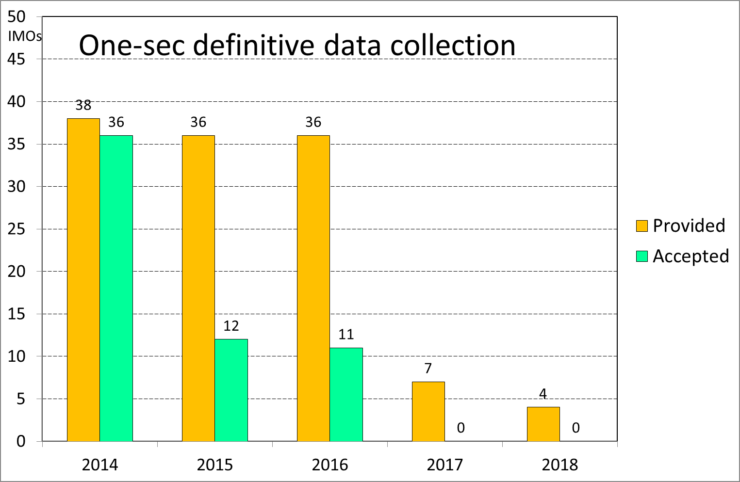

Slide 4
Requested data formats for 1-sec definitive
2014 IAGA2002
2015 forwards CDF
Real situation regarding data formats
2014 IMOs provided IAGA2002
2015-2019 the most IMOs provide CDF except of USGS (still IAGA2002)
Problems
The most important thing that should be done while checking is comparison with 1-min definitive, for this purpose we need to convert CDF to IAF
There are difficulties related conversion CDF to IAF
Paradoxically, actually it is easier to check 1-sec/IAGA2002 than 1-sec/CDF
A lack of people who have time for checking 1-sec definitive, what is certainly much more time-consuming than checking 1-min data

Slide 5
Thank you for your attention !

